Slide 1
Module 8 – Working with RESTful APIs & JSON in Flutter
Notes:
Calling web services, parsing JSON, and integrating data into your UI
Introduce that this module connects the app to real-world data over the network. It builds on async concepts (Futures/async-await) and prepares for storage in later modules.

Slide 2
Learning Objectives
Content:
Understand basic HTTP and RESTful API concepts
Send GET requests in Flutter using the http package
Parse JSON responses into Dart model classes
Display API data using FutureBuilder + ListView
Handle loading, empty, and error states
Send POST requests to create or submit data
Organize API logic using a reusable Service Layer pattern
Notes:
References
Mastering Flutter 2025
Chapter: Networking & JSON
Chapter: Asynchronous Programming (Futures & async/await)
Notes:
Connect clearly with previous modules: we now move from static/local data to remote data.

Slide 3
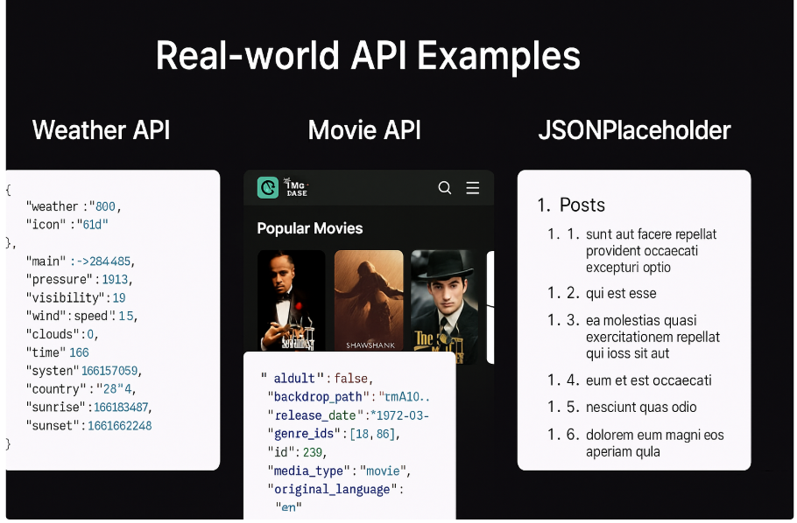
What is an API? What is HTTP?
API (Application Programming Interface)
A contract that allows clients to talk to a server
Often exposed as a set of URLs (endpoints)
HTTP fundamentals
Methods: GET, POST, PUT, DELETE
Status codes:
200–299: success
400–499: client error
500–599: server error
Notes:
Look at these three images: APIs are not just theoretical. The detailed data you see every day is also an API. The movie viewing application that everyone loves uses APIs to download movie posters and descriptions.During the course, we will start with JSONPlaceholder – the simplest but extremely effective API to understand the working mechanism.
These three APIs represent three important data groups: realtime, media and mock APIs.When doing the lab or final project, students can choose any group to develop their own application.

Slide 4
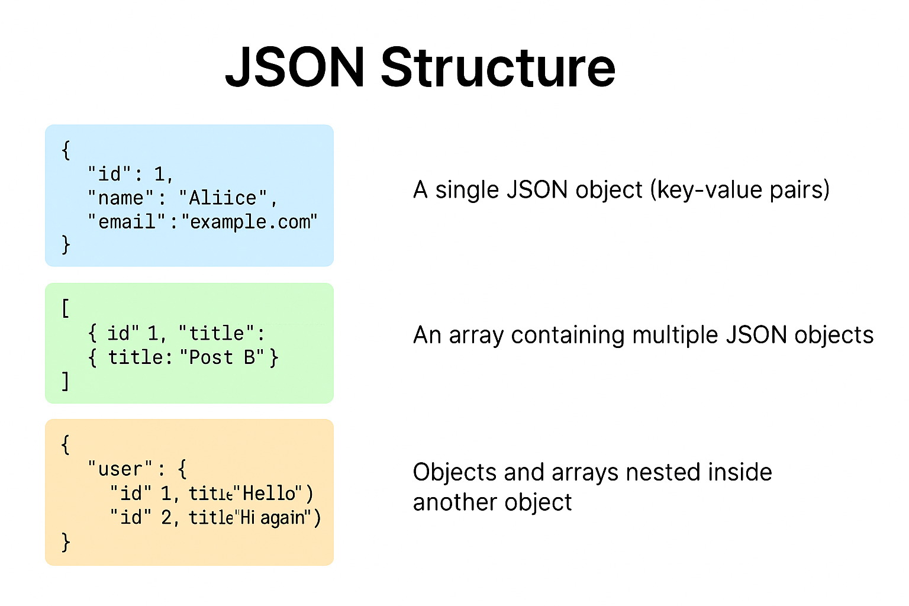
What is JSON?
JSON (JavaScript Object Notation)
A lightweight text format for data exchange
Key–value pairs and arrays
Easy to read and parse
Maps naturally to Dart structures: Map<String, dynamic> and List<dynamic>
JSON in APIs
APIs return JSON → your Flutter app decodes → maps to Model classes.
Notes:
JSON is used in most APIs because it is lightweight, easy to parse and compatible with all languages.
Important point: JSON is not an object of Dart → need to be converted by json.decode() and then map to Model class (Post, Movie, User...).
JSON object is compatible with Map<String, Dynamic> in Dart.JSON array is compatible with List<dynamic> or List<Model> after parsing.
Reminder for students: data from the network is always String, Flutter must decode and process it.
Example to illustrate when learning:"When we call the API from JSONPlaceholder, the server returns an array of 100 posts. Each post is a JSON object. Flutter will read this array → create List<Post> → display ListView."

Slide 5
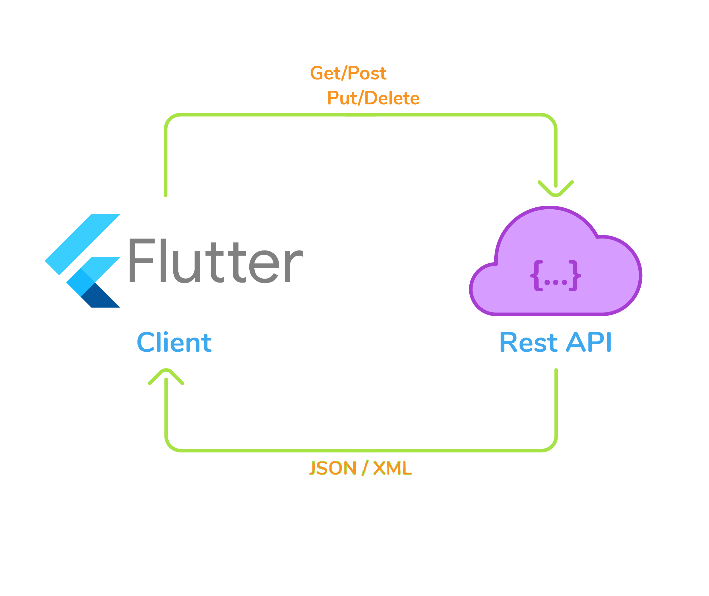
API Networking in Flutter — The Big Picture
Steps to call an API in Flutter
Choose an endpoint (URL + method)
Send the request using http client
Receive JSON response
Decode JSON → Dart models
Update UI with the data
Handle loading & error states
Notes:
Emphasize that API calls are asynchronous. Students must understand Future, async/await, and state management before implementing real HTTP flows.

Slide 6

Using the http Package
Common approach in Flutter
Add dependency in pubspec.yaml: http
Import in Dart file:
Typical usage
http.get(Uri.parse(url))
http.post(Uri.parse(url), body: {...})
Notes:
Mention that in DartPad / online environments, students may need to add the http package in the dependencies panel.

Slide 7
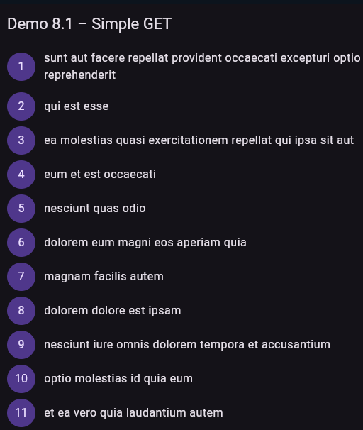
Demo 8.1: Simple GET Request
Goal: Fetch data from a public REST API using an HTTP GET request and print the response.
This demo demonstrates how to make a basic GET request in Flutter using the http package.
The app will fetch a list of posts from the public API (https://jsonplaceholder.typicode.com/posts) and display the title of the first item.
Steps to follow
Send an asynchronous HTTP GET request
Decode JSON into Dart objects
Handle loading status
Update UI when data arrives
Notes:
Core code snippet:
Future<void> fetchPosts() async {
final url = Uri.parse('https://jsonplaceholder.typicode.com/posts');
final response = await http.get(url);
if (response.statusCode == 200) {
print('Response body: ${response.body}');
} else {
print('Request failed: ${response.statusCode}');
}
}

Slide 8
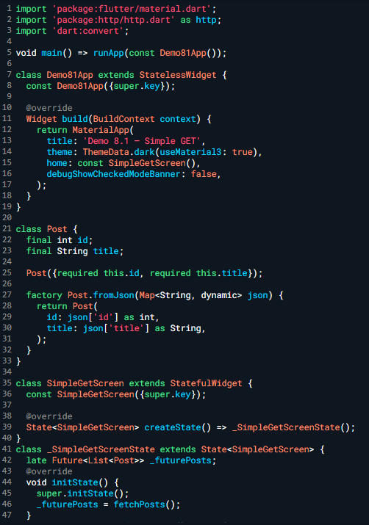
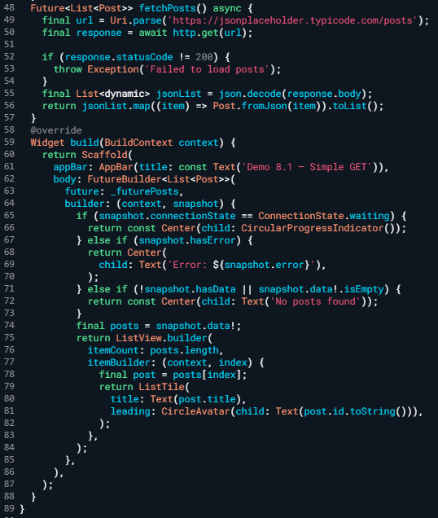
Demo 8.1: Simple GET Request

Slide 9
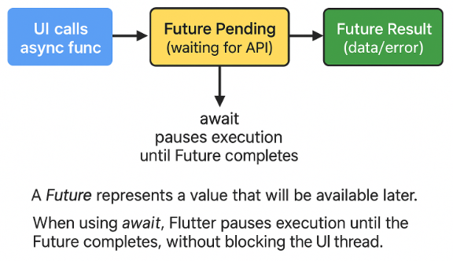
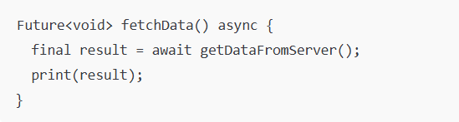
Futures & async/await (Quick Review)
Key Concepts
Future<T> represents a value that will be available later
async marks a function as asynchronous
await pauses execution until a Future completes
Exam:
Why async matters for Networking?
Prevents UI freezing while waiting for network responses
Lets Flutter handle long-running tasks efficiently
Required for all HTTP operations
Notes:
Future = a value that will be available later
async = marks a function as asynchronous
await = pause until a Future completes
Connect this directly to await http.get(url) in Demo 8.1.

Slide 10
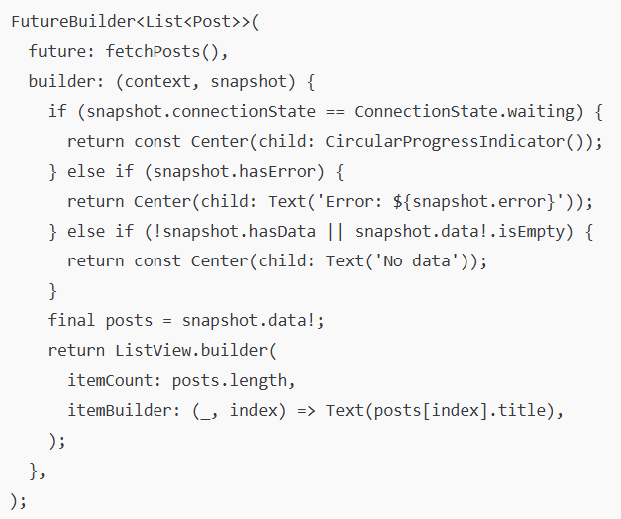
FutureBuilder: Binding Data to UI
Why FutureBuilder?
Integrates async calls into the widget tree
Handles loading, success, and error states in one place
This FutureBuilder listens to fetchPosts() and rebuilds the UI based on the Future state:
waiting: show a loading spinner
error: display the error message
no data: show a “No data” message
data loaded: build a ListView of post titles
Notes:
Explain each branch clearly (loading / error / empty / success).
The widget automatically updates when the Future completes, making it ideal for one-time API calls.
Demo 8.1 – SimpleGet

Slide 11
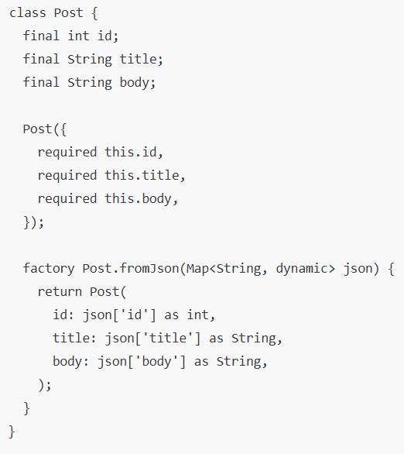
Parsing JSON into Dart Models
Why use model classes?
Type safety
Clear structure
Easier to maintain and reuse
Example model:
Notes:
Highlight that model classes will appear in many modules (storage, state management, etc.).

Slide 12
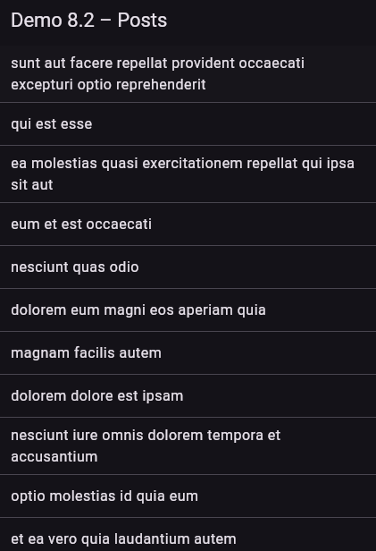
Demo 8.2 – JsonModelScreen
Objective
Convert JSON into a Dart model
Display list items and navigate to a Detail Screen with full data
Steps
Create a model with fromJson
Fetch and decode JSON
Show list of items
Tap an item → open Detail Screen
Display selected item’s fields
Notes:
Cdoe demo 8.2
import 'package:flutter/material.dart';
import 'package:http/http.dart' as http;
import 'dart:convert';
void main() => runApp(const Demo82App());
class Demo82App extends StatelessWidget {
const Demo82App({super.key});
@override
Widget build(BuildContext context) {
return MaterialApp(
title: 'Demo 8.2 – JSON Model & Detail Screen',
theme: ThemeData.dark(useMaterial3: true),
home: const PostListScreen(),
debugShowCheckedModeBanner: false,
);
}
}
//
// STEP 1 — Create a Dart model & implement fromJson()
// (Objective: Convert JSON map → Dart object)
//
class Post {
final int id;
final String title;
final String body;
Post({
required this.id,
required this.title,
required this.body,
});
factory Post.fromJson(Map<String, dynamic> json) {
return Post(
id: json['id'] as int,
title: json['title'] as String,
body: json['body'] as String,
);
}
}
class PostListScreen extends StatefulWidget {
const PostListScreen({super.key});
@override
State<PostListScreen> createState() => _PostListScreenState();
}
class _PostListScreenState extends State<PostListScreen> {
late Future<List<Post>> _futurePosts;
@override
void initState() {
super.initState();
//
// STEP 2 — Fetch & decode JSON
// Use http.get → decode → convert each map into a Post model
//
_futurePosts = fetchPosts();
}
Future<List<Post>> fetchPosts() async {
final url = Uri.parse('https://jsonplaceholder.typicode.com/posts');
final response = await http.get(url);
if (response.statusCode != 200) {
throw Exception('Failed to load posts');
}
final List<dynamic> jsonList = json.decode(response.body);
return jsonList.map((e) => Post.fromJson(e)).toList();
}
//
// STEP 3 — Build a ListView of items
// Titles appear in list; tapping an item opens the detail screen.
//
void _openDetails(Post post) {
Navigator.of(context).push(
MaterialPageRoute(
builder: (_) => PostDetailScreen(post: post),
),
);
}
@override
Widget build(BuildContext context) {
return Scaffold(
appBar: AppBar(title: const Text('Demo 8.2 – Posts')),
body: FutureBuilder<List<Post>>(
future: _futurePosts,
builder: (context, snapshot) {
if (snapshot.connectionState == ConnectionState.waiting) {
return const Center(child: CircularProgressIndicator());
} else if (snapshot.hasError) {
return Center(child: Text('Error: ${snapshot.error}'));
} else if (!snapshot.hasData || snapshot.data!.isEmpty) {
return const Center(child: Text('No posts'));
}
final posts = snapshot.data!;
return ListView.separated(
itemCount: posts.length,
separatorBuilder: (_, __) => const Divider(height: 0),
itemBuilder: (context, index) {
final post = posts[index];
return ListTile(
title: Text(post.title),
onTap: () => _openDetails(post), // STEP 4 — Navigate to DetailScreen
);
},
);
},
),
);
}
}
//
// STEP 5 — Build the DetailScreen
// The selected Post model is passed into this screen and displayed.
//
class PostDetailScreen extends StatelessWidget {
final Post post;
const PostDetailScreen({super.key, required this.post});
@override
Widget build(BuildContext context) {
return Scaffold(
appBar: AppBar(title: Text('Post #${post.id}')),
body: Padding(
padding: const EdgeInsets.all(16),
child: Text(post.body),
),
);
}
}

Slide 13
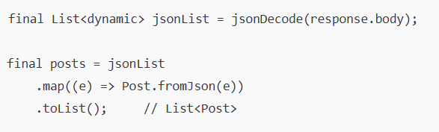
Converting JSON List to List<Model>
Key Idea
Convert a JSON array (list of objects) into a typed List<Model> using decoding + mapping.
JSON → Dart Conversion
Concepts
JSON list = array of multiple objects
jsonDecode() → returns List<dynamic>
.map() → converts each JSON item to a Model
.toList() → final typed list (List<Post>)
Notes:
DEMO 8.2 — JSON Model & Detail Screen step 3: Convert JSON List → List<Model>

Slide 14
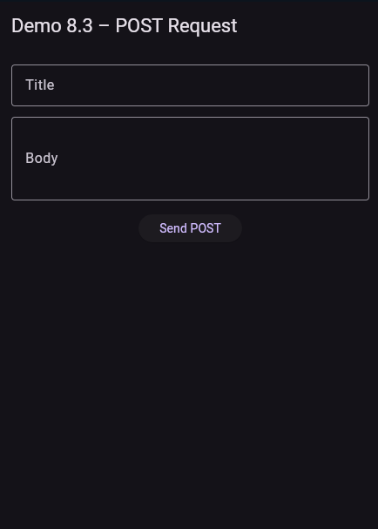
Demo 8.3: Sending Data via POST
Objectives
Send data to an API using POST
Show loading, success, and error states
Allow user to retry on failure
Steps
Build a simple input form
Send POST request (http.post)
Encode JSON body
Show loading indicator
Handle error → show message + Retry button
Display success response
Notes:
Code demo 8.3 – POST Request
import 'dart:convert';
import 'package:flutter/material.dart';
import 'package:http/http.dart' as http;
void main() {
runApp(const Demo83App());
}
class Demo83App extends StatelessWidget {
const Demo83App({super.key});
@override
Widget build(BuildContext context) {
return MaterialApp(
title: 'Demo 8.3 – POST Request',
theme: ThemeData.dark(useMaterial3: true),
home: const CreatePostDemo(),
debugShowCheckedModeBanner: false,
);
}
}
class CreatePostDemo extends StatefulWidget {
const CreatePostDemo({super.key});
@override
State<CreatePostDemo> createState() => _CreatePostDemoState();
}
class _CreatePostDemoState extends State<CreatePostDemo> {
final titleController = TextEditingController();
final bodyController = TextEditingController();
bool isLoading = false;
String? result;
String? errorMessage;
// --------------------------------------------------------
// STEP 2 — Send POST request (http.post)
// STEP 3 — Encode JSON body before sending
// --------------------------------------------------------
Future<void> createPost() async {
setState(() {
isLoading = true; // STEP 4 — Show loading indicator
errorMessage = null;
result = null;
});
final url = Uri.parse('https://jsonplaceholder.typicode.com/posts');
try {
final response = await http.post(
url,
headers: {'Content-Type': 'application/json; charset=UTF-8'},
body: json.encode({
'title': titleController.text,
'body': bodyController.text,
'userId': 1,
}),
);
if (response.statusCode == 201) {
setState(() {
result = response.body; // STEP 6 — Display success response
});
} else {
throw Exception('Failed with status: ${response.statusCode}');
}
} catch (e) {
setState(() {
errorMessage = e.toString(); // STEP 5 — Handle error
});
} finally {
setState(() {
isLoading = false;
});
}
}
// --------------------------------------------------------
// STEP 1 — Build a simple input form (title + body)
// --------------------------------------------------------
@override
Widget build(BuildContext context) {
return Scaffold(
appBar: AppBar(title: const Text('Demo 8.3 – POST Request')),
body: Padding(
padding: const EdgeInsets.all(16),
child: Column(
children: [
TextField(
controller: titleController,
decoration: const InputDecoration(
labelText: 'Title',
border: OutlineInputBorder(),
),
),
const SizedBox(height: 12),
TextField(
controller: bodyController,
maxLines: 3,
decoration: const InputDecoration(
labelText: 'Body',
border: OutlineInputBorder(),
),
),
const SizedBox(height: 16),
ElevatedButton(
onPressed: isLoading ? null : createPost,
child: isLoading
? const SizedBox(
width: 18,
height: 18,
child: CircularProgressIndicator(strokeWidth: 2),
) // STEP 4 — loading indicator
: const Text('Send POST'),
),
const SizedBox(height: 20),
// STEP 5 — Error handling UI + Retry
if (errorMessage != null) ...[
Text('Error: $errorMessage',
style: const TextStyle(color: Colors.red)),
TextButton(
onPressed: () => setState(() {}),
child: const Text('Retry'),
),
],
// STEP 6 — Display success result
if (result != null) ...[
const Text(
'Success!',
style: TextStyle(color: Colors.green, fontWeight: FontWeight.bold),
),
const SizedBox(height: 8),
Expanded(
child: SingleChildScrollView(
child: Text(
result!,
style: const TextStyle(fontSize: 13),
),
),
),
],
],
),
),
);
}
@override
void dispose() {
titleController.dispose();
bodyController.dispose();
super.dispose();
}
}

Slide 15
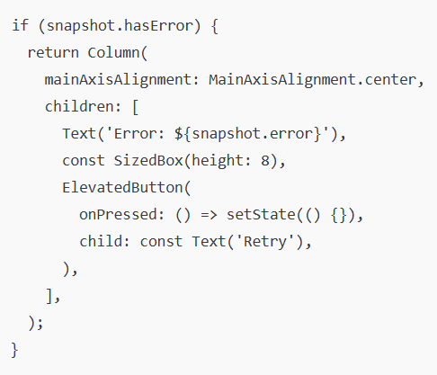
Error Handling & Retry
Common failure cases
No internet connection
Server error (500)
Invalid JSON
Timeout
Basic strategies
Throw exceptions in fetch functions
Show friendly error messages in UI
Offer a “Retry” button
Simple UI example:
Notes:
Encourage students not to ignore errors; robust apps handle them gracefully.
Demo 8.3 step 5

Slide 16
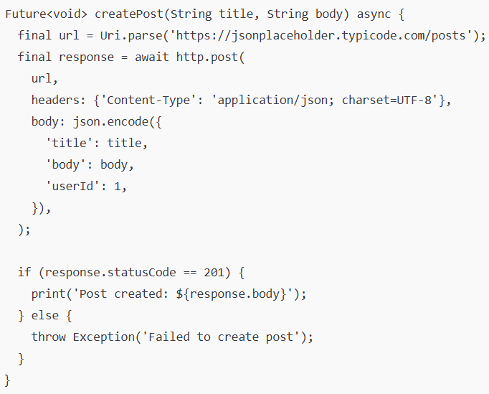
POST Request + Error Handling Pattern
Explanation
This block handles errors during the POST request.
If the FutureBuilder detects an error (snapshot.hasError), it shows:
The error message
A Retry button that triggers setState() to run the request again
It provides simple error feedback and a way for the user to retry the API call.
Basic pattern:
Notes:
Note: etState() forces the widget to rebuild, causing the POST request future to be executed again. This is a common pattern for retrying failed network calls.
Demo 8.3 step 2,3,5

Slide 17
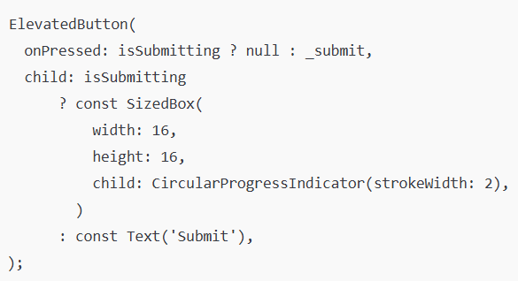
Loading & Button States (UX)
Good UX patterns
Disable submit button while request is in progress
Show a loading indicator (spinner)
Prevent double-submit
Key idea:
Avoid double submit while loading
Notes:
Relate this to async checks in module 7 and Lab 7.4.
“In Module 7, we learned how to disable the button when the form is invalid or processing the form.
In Demo 8.3, we apply this logic again but for real async tasks (sending data to the API).
That is, when the POST request is running, the button must be disabled to avoid sending 2–3 requests at the same time.”

Slide 18
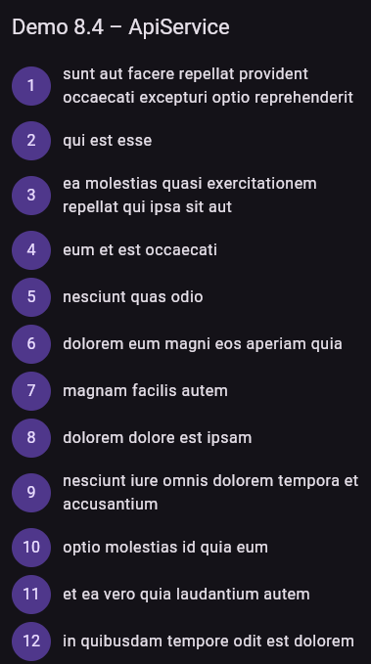
Demo 8.4 – ApiService
Objectives
Move HTTP logic into a separate service
Keep UI clean and focused
Reuse the same service across screens
Steps
Create Post model
Implement ApiService.fetchPosts()
Call service in initState()
Use FutureBuilder to load + show list
Notes:
Code demo 8.4 -ApiService
import 'package:flutter/material.dart';
import 'package:http/http.dart' as http;
import 'dart:convert';
void main() => runApp(const Demo84App());
class Demo84App extends StatelessWidget {
const Demo84App({super.key});
@override
Widget build(BuildContext context) {
return MaterialApp(
title: 'Demo 8.4 – ApiService',
theme: ThemeData.dark(useMaterial3: true),
home: const ApiServiceDemoScreen(),
debugShowCheckedModeBanner: false,
);
}
}
// ----------------------------------------------
// STEP 1 — Create Model (Post + fromJson)
// ----------------------------------------------
class Post {
final int id;
final String title;
Post({required this.id, required this.title});
factory Post.fromJson(Map<String, dynamic> json) {
return Post(
id: json['id'] as int,
title: json['title'] as String,
);
}
}
// ----------------------------------------------
// STEP 2 — Build ApiService (fetchPosts())
// ----------------------------------------------
class ApiService {
final http.Client client;
ApiService({http.Client? client}) : client = client ?? http.Client();
Future<List<Post>> fetchPosts() async {
final url = Uri.parse('https://jsonplaceholder.typicode.com/posts');
final response = await client.get(url);
if (response.statusCode != 200) {
throw Exception('Failed to load posts');
}
final List<dynamic> jsonList = json.decode(response.body);
return jsonList.map((e) => Post.fromJson(e)).toList();
}
}
class ApiServiceDemoScreen extends StatefulWidget {
const ApiServiceDemoScreen({super.key});
@override
State<ApiServiceDemoScreen> createState() => _ApiServiceDemoScreenState();
}
class _ApiServiceDemoScreenState extends State<ApiServiceDemoScreen> {
late final ApiService _apiService;
late Future<List<Post>> _futurePosts;
@override
void initState() {
super.initState();
// ----------------------------------------------
// STEP 3 — Inject Service & call fetchPosts()
// ----------------------------------------------
_apiService = ApiService();
_futurePosts = _apiService.fetchPosts();
}
@override
Widget build(BuildContext context) {
return Scaffold(
appBar: AppBar(title: const Text('Demo 8.4 – ApiService')),
// ----------------------------------------------
// STEP 4 — Render data using FutureBuilder
// ----------------------------------------------
body: FutureBuilder<List<Post>>(
future: _futurePosts,
builder: (context, snapshot) {
if (snapshot.connectionState == ConnectionState.waiting) {
return const Center(child: CircularProgressIndicator());
}
else if (snapshot.hasError) {
return Center(child: Text('Error: ${snapshot.error}'));
}
else if (!snapshot.hasData || snapshot.data!.isEmpty) {
return const Center(child: Text('No posts'));
}
final posts = snapshot.data!;
return ListView.builder(
itemCount: posts.length,
itemBuilder: (_, index) {
final post = posts[index];
return ListTile(
title: Text(post.title),
leading: CircleAvatar(child: Text(post.id.toString())),
);
},
);
},
),
);
}
}

Slide 19
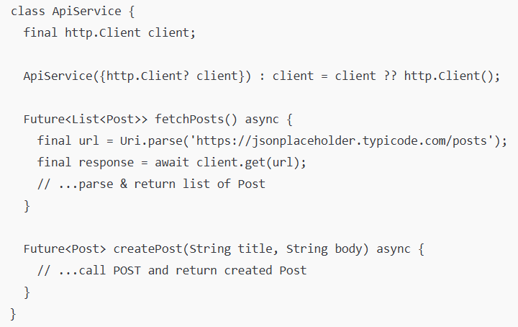
Organizing Networking Code (Demo 8.4)
Service Layer Pattern
Create a class to encapsulate API logic
Keep widget code clean and focused on UI
Example:
Notes:
Demo 8.4 –ApiService step 2 Build ApiService

Slide 20
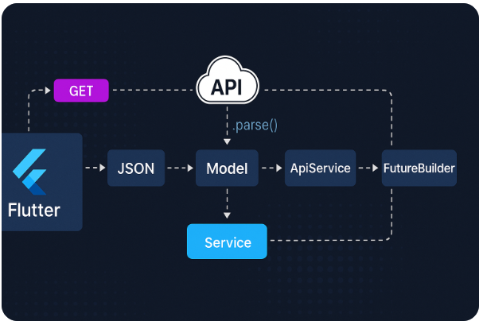
From API to UI: Putting It All Together
End-to-end flow
User opens screen
App calls ApiService.fetchPosts()
FutureBuilder shows loading → data / error
User taps “Add” and opens form
Form submits createPost()
On success: show message, update list (re-fetch or optimistic update)
Notes:
Demo 8.4 ApiService step 4 – Render data using FutureBuilder

Slide 21
Common Pitfalls & Best Practices
Pitfalls
Calling APIs in build() instead of initState()
Not handling errors → app crashes
Blocking the UI thread with heavy parsing
Hardcoding URLs everywhere
Best Practices
Call API once in initState()
Centralize base URL and endpoints
Wrap networking in service classes):
Log responses during development

Slide 22
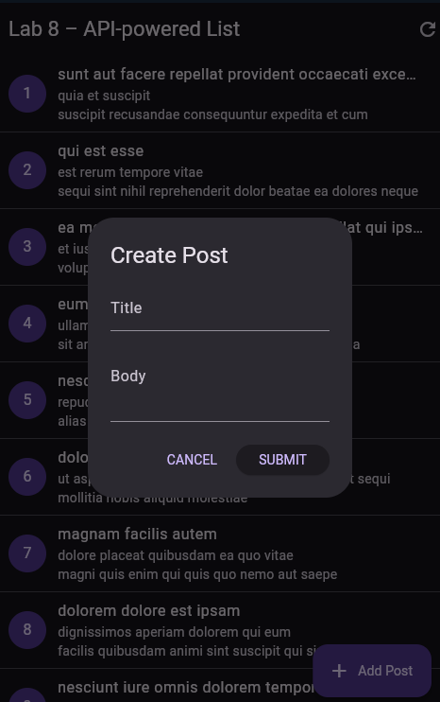
Lab 8 Overview
Objectives: Building a Simple API-powered List Screen
You will:
Call a public REST API
Parse JSON into model classes
Display a list of items using ListView
Show loading + error states
(Optional) Add a simple POST form to create a new item
Note: This lab combines all concepts from Demos 8.1 → 8.4
Notes:
Since Lab 8 is the last lab of Module 8, students are required to:
Call API (8.1)
Parse JSON → Model (8.2)
Render UI using ListView + FutureBuilder (8.2 & 8.4)
Add loading & error reporting interface (8.3 & 8.4)
(Optional) POST / create new data (8.3)
→ Lab = combined practice instead of individual demos

Slide 23
Summary
In this module, you learn how to:
Understand how RESTful APIs work
Send HTTP GET and POST requests in Flutter
Decode JSON strongly into typed Dart model classes
Display API data with FutureBuilder and ListView
Implement loading, empty, and error UI states
Organize networking code into a clean, reusable service layer
(Optional): Build a simple form that sends data via POST

Slide 24
References
Mastering Flutter 2025 – Ch.3, 4, 9
docs.flutter.dev
https://dartpad.dev

